Slide 1

Comprehensive Analysis of Car Sales Dynamics
By Nitin Kumar
Video Presentation Link: https://www.loom.com/share/a222d7050c874cc99c4be4d29855da79?sid=8030ed36-0dc8-4697-9469-45985fe68191

Slide 2

Purpose of the Car Sales Analysis
Analyze customer demographics and dealer performance to enhance product offerings and pricing strategies, leading to improved market positioning and profitability for Octro Inc. This data-driven approach aims to identify and capitalize on emerging trends in car sales.

Slide 3


Car Sales Analysis Introduction
Customer Insights
1
Analyze customer demographics to segment buyers effectively, enhancing targeted marketing and product offerings tailored to distinct customer preferences and purchasing behaviors.
Dealer Performance
2
Evaluate dealer performance through metrics like sales volumes and customer satisfaction, allowing for strategic interventions that boost underperforming dealers and recognize top performers.

Slide 4


Customer Segmentation Overview
Targeted Marketing
1
Utilize segmented data to tailor marketing campaigns that resonate with specific customer groups, increasing engagement and conversion rates for targeted promotions.
Product Development
2
Develop new car models or features that align with the preferences and needs of distinct customer segments, ensuring that offerings meet market demand effectively.
Sales Strategies
3
Implement customized sales strategies for different segments, focusing on preferred communication styles and sales approaches to enhance customer satisfaction and drive sales.

Slide 5

Key Objectives for Customer Insights
Segment Customers
01
Identify distinct groups based on demographics and purchasing behavior.
Analyze Preferences
02
Determine model preferences for each identified customer segment.
Visualize Demographics
03
Use graphs to showcase demographic distributions and customer insights.
Identify Trends
Enhance Offerings
Drive Marketing
04
Uncover purchasing trends based on age, income, and vehicle type.
05
Tailor products to meet the specific needs of customer segments.
06
Develop targeted marketing strategies aligned with customer insights.

Slide 6
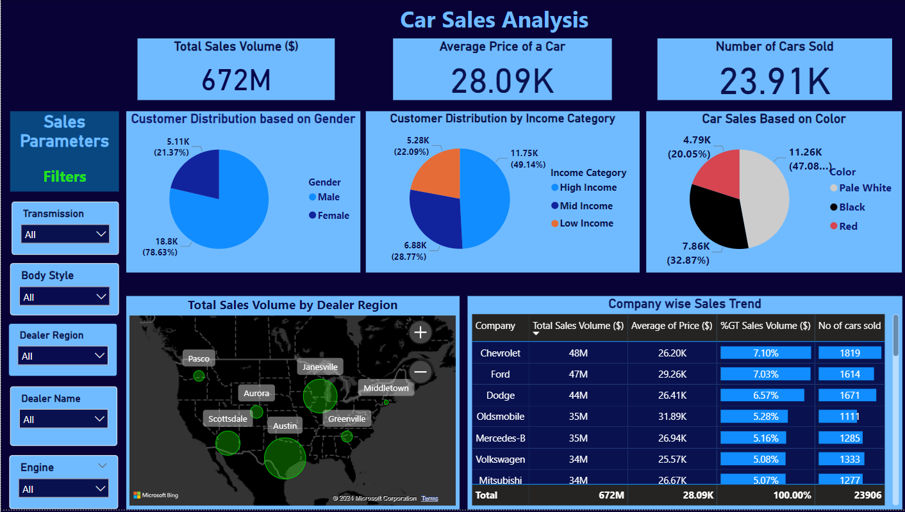
Car Sales Dashboard: Customer Segmentation & Preference Analysis

Slide 7
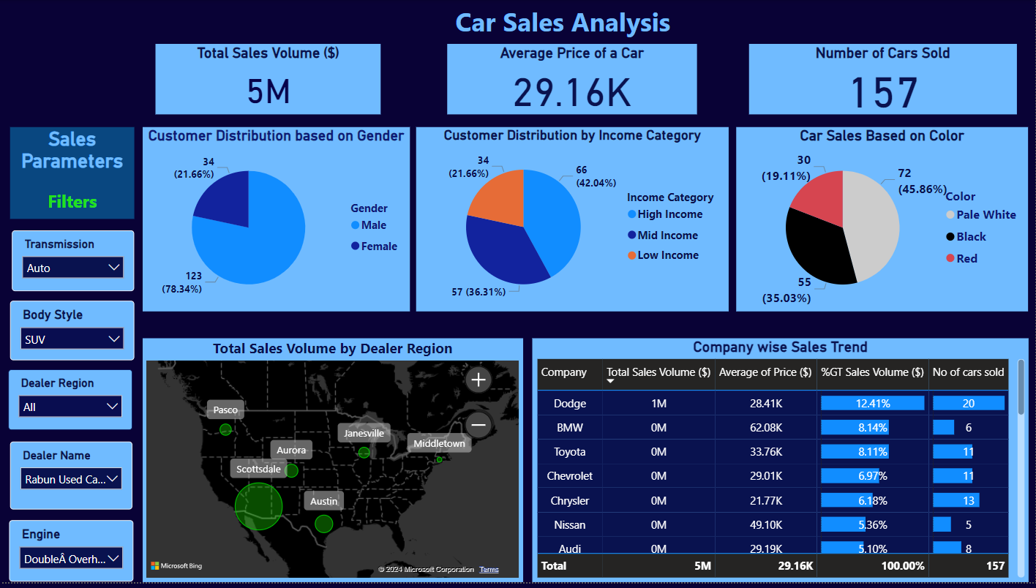
Car Sales Dashboard: Customer Segmentation & Preference Analysis

Slide 8
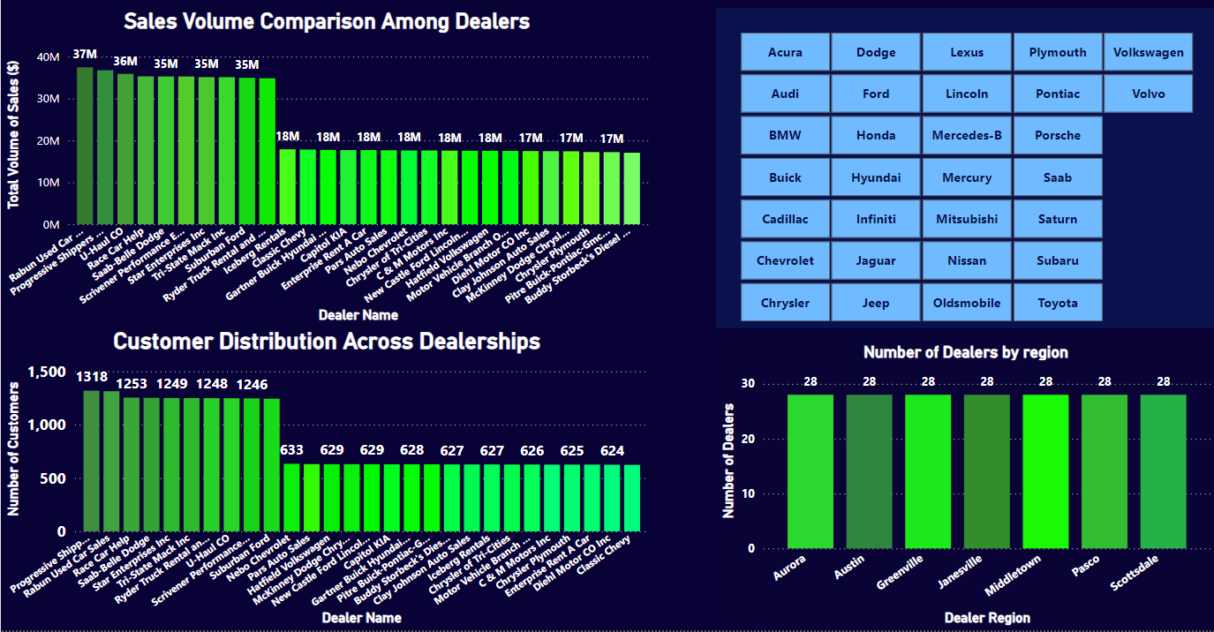
Dealer Performance Evaluation

Slide 9
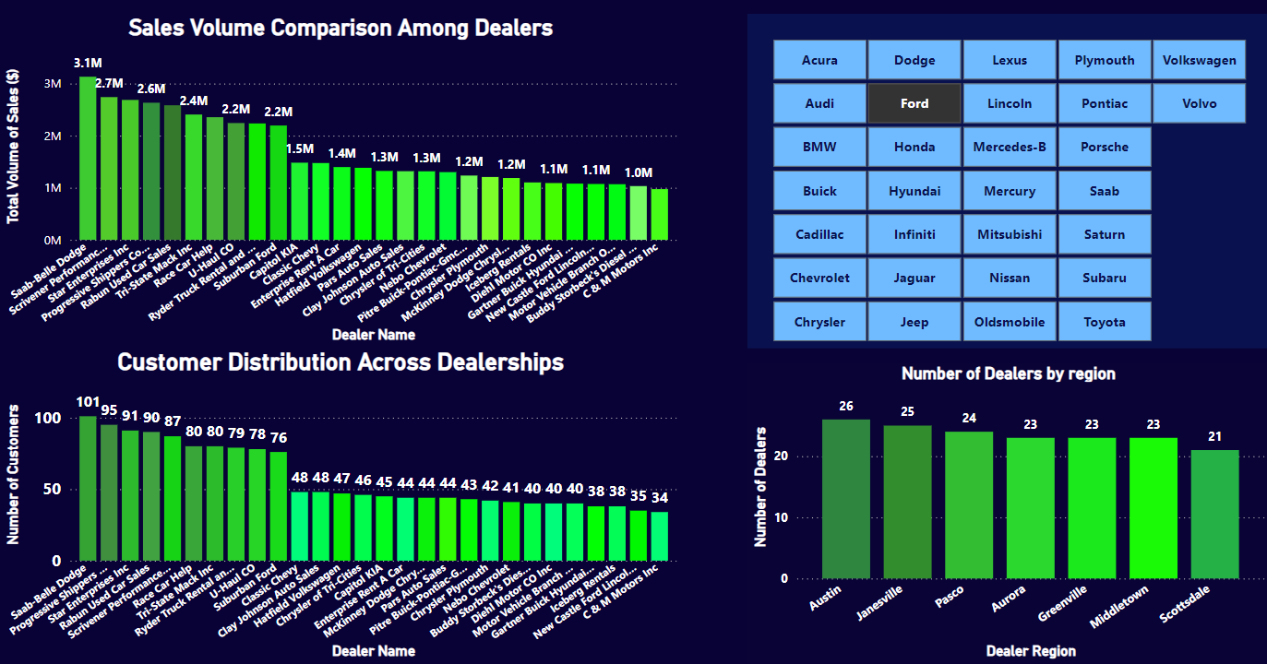
Dealer Performance Evaluation (individual companies)

Slide 10
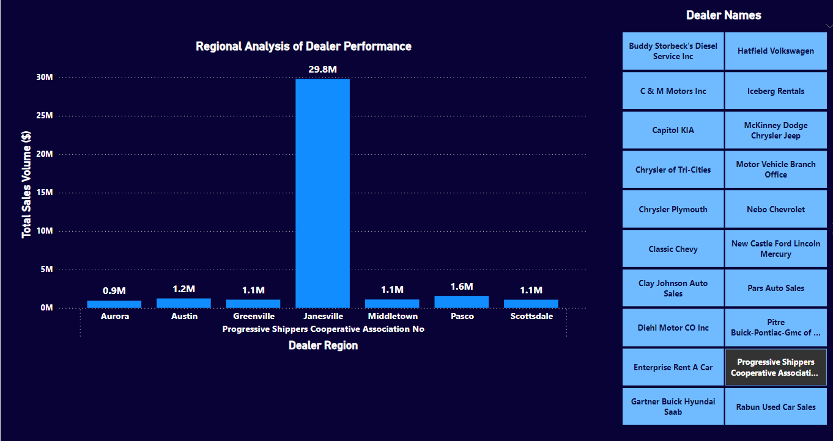
Regional Analysis of Dealer Performance

Slide 11
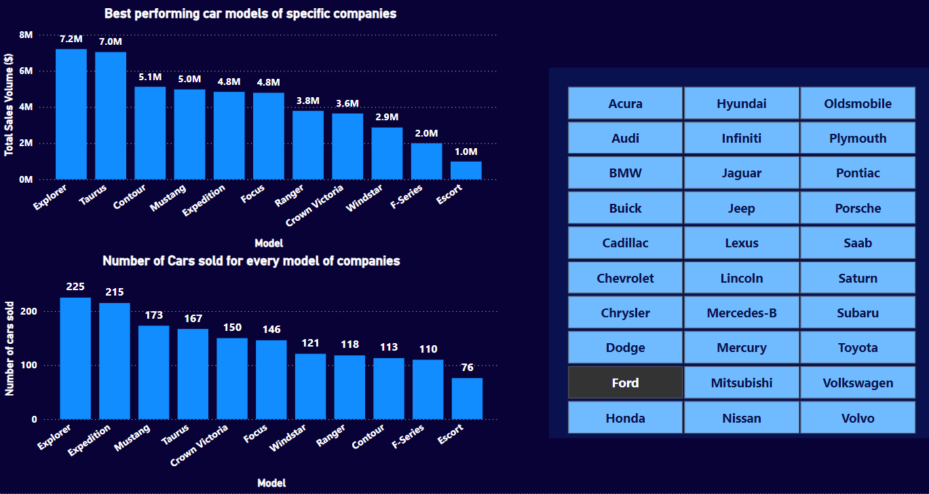
Product Pricing and Profitability: A comparison of car models based on pricing and sales volume

Slide 12
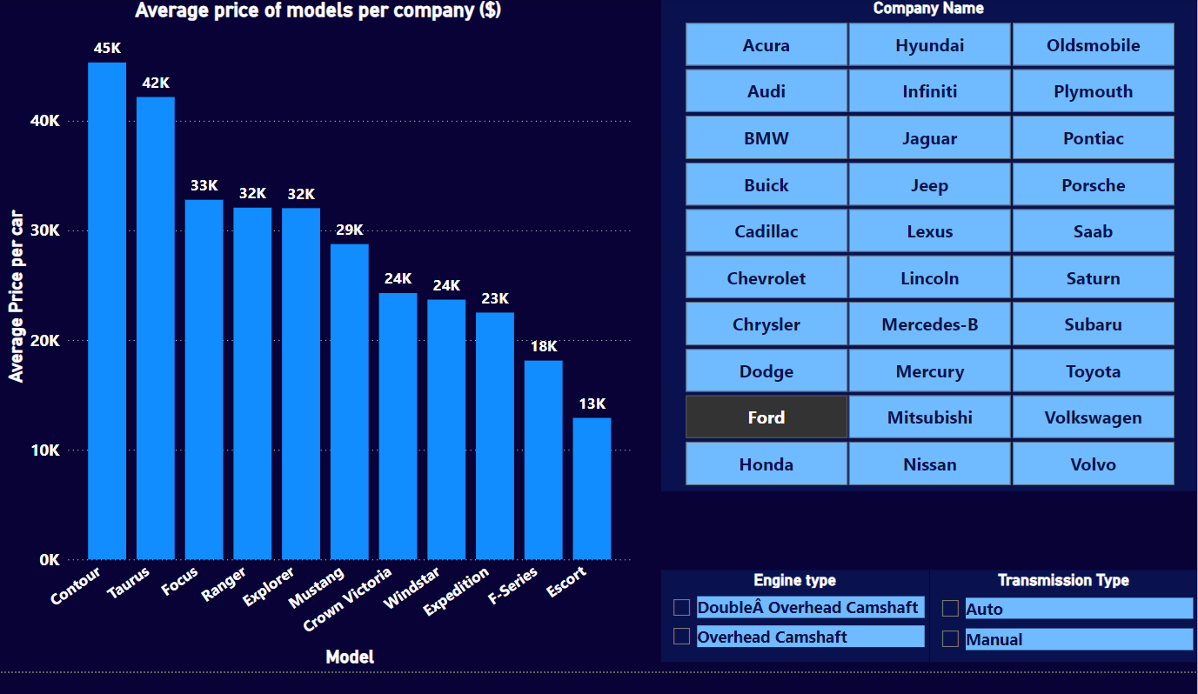
Product Pricing and Profitability: A comparison of car models based on pricing and sales volume

Slide 13

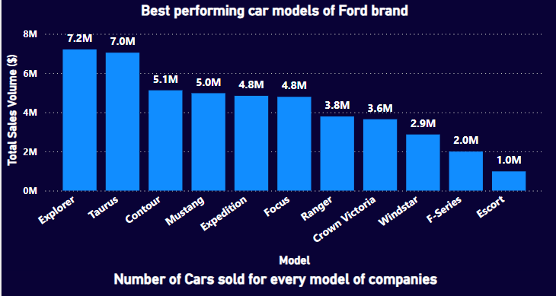
Product Pricing and Profitability: Recommendations for adjusting prices to maximize revenue.
Objective : Analyze pricing strategies for the Ford Company’s Windstar model and recommend an optimal price to maximize profitability.
Using Random Forest Regression, to predict the optimal price based on historical data of prices and sales volumes.
1
Using average price of a Windstar car model of Ford brand Assuming we have a profit margin of 20% Average price: $23682.84 Estimated Revenue: $2.8 Million Estimated Profit: $573124.73
A bar plot visualizing the Total Sales Volume($) of all the car models of Ford brand

Slide 14
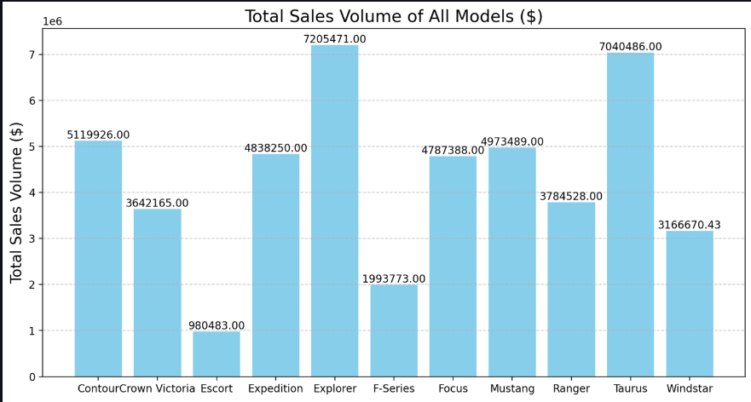
Product Pricing and Profitability: Recommendations for adjusting prices to maximize revenue.
2
Using recommended price of a Windstar car model of Ford brand Assuming we have a profit margin of 20% Recommended price: $26170.83 Estimated Revenue: $3.1 Million Estimated Profit: $633333.98 Profit increase with recommended price: $60209.26
Revenue increase with recommended price: $301046.28
A bar plot visualizing the Total Sales Volume($) of all the car models of Ford brand after they are sold at the recommended price

Slide 15
Strategic Recommendations for Product and Dealer Partnerships
1
Product and Pricing Recommendations
Price Optimization: From the existing price simulations and predictive models, we can recommend price adjustments to maximize revenue. For models where a higher price is shown to result in slightly lower sales volume but significantly increased revenue, we can recommend a price increase. For models with lower sales volumes despite lower prices, we can recommend exploring price reductions or bundling strategies to drive demand.
Product Demand Analysis: We identify top-selling models and recommend boosting production or increasing marketing around those models. For models with declining sales, we can suggest phasing out or redesigning based on customer feedback.
New Product Introductions: Based on customer segmentation analysis, we can identify gaps in the market (e.g., lack of mid-range electric vehicles, SUVs with advanced tech features) and recommend introducing new models targeting these segments.

Slide 16
Strategic Recommendations for Product and Dealer Partnerships
2
Dealer Partnership Strategies
Performance-Based Partnerships: We should reward top-performing dealers with better commissions or exclusive rights to new models. For low-performing dealer we can provide additional training and incentives to boost their sales performance.
Regional Dealer Strategy: We have to analyze regional sales performance to identify underperforming regions and then develop strategies such as regional marketing campaigns or product lines tailored to regional preferences. Then recommend consolidating partnerships in regions where several dealers are underperforming and establish stronger relationships with the best-performing ones.

Slide 17
Thank You

